Slide 1



PYTHON PROJECT
PRESENTATION
By- ARPIT KUMAR

Slide 2

TABLE OF CONTENTS
Introduction
Objectives of the Project
Scope of the Project
Application Tools
Project Design
Flowchart
Snapshots
Testing & Validation
Conclusion

Slide 3
Introduction
The Turtle Crossing Game is an interactive and visually engaging project developed using Python's Turtle module.This game challenges players to navigate a turtle across a busy road filled with moving obstacles, aiming to reach the finish line without collisions.
The project employs object-oriented principles with three main classes: Player, CarManager, and Scoreboard. These classes work cohesively to handle player controls, obstacle management, and level progression. The game also features dynamic difficulty, with increasing car speeds as players advance through levels.
Beyond providing an enjoyable gameplay experience, the Turtle Crossing Game serves as a hands-on learning tool, demonstrating key programming concepts such as event handling,collision detection, and progressive challenge design. This project is an excellent example of how Python can be used to create fun and educational applications.

Slide 4
Objectives of the project
Develop Core Game Mechanics: Implement essential gameplay mechanics, including player movement, jumping, shooting, and item collection.
Create a Multi-Level Environment: Design and implement a multi-level environment where players progress through levels, encountering varied challenges, obstacles, and enemies.
Ensure Smooth Player Experience and Controls: Design intuitive controls for movement and item interaction, ensuring responsive gameplay. Optimize game performance to maintain a stable frame rate and smooth animations throughout gameplay.

Slide 5
Scope of the project
Single-Player Gameplay:The game provides a solo experience where the player guides a turtle across a road filled with moving cars, aiming to reach the finish line without collisions.
Obstacle and Collision Management:Cars are dynamically generated with varying speeds and colors, creating a challenging obstacle course. Collisions with cars result in a game-over state, displayed with appropriate visual feedback.
Level Progression System:The game incorporates a progression system where each successful crossing advances the player to a new level. With each level, car speeds increase, adding to the difficulty and excitement.
Visual Feedback and Engagement:Includes visually appealing graphics, such as an animated turtle, colorful cars, and a dynamic game environment, ensuring an engaging player experience.

Slide 6
Application Tools
Programming language: Python is used to implement game logic, handling, animations,animations managing game mechanisms.
Libraries: Pygame, core libraries for game development, enabling sprite management, event handling, and rendering of graphics and sounds.
Development Tools: IDEs, Python for coding, debugging, and managing project files.
Testing Tools: Pygame game, debugging features, for monitoring game state.
Level Design Tools: CSV Editors, Microsoft Excel, Google sheet

Slide 7
Project Design
Game Initialization and Setup:
Main Game Settings: Configures screen dimensions (600x600 pixels), game variables, and initializes the Turtle module for gameplay.
Display and Clock: Sets up the game screen and refresh rate to ensure smooth animations.
Player Class: handles turtle movement, position reset, and checks if the player has reached the finish line.
CarManager Class: Manages the cars on the road, their movement, and increasing their speed with each level.
Scoreboard Class: Displays the current level and "Game Over" message, tracks progress, and updates the level as the player advances.
Supporting Functions:
Gameplay Logic: Updates player movement, car behavior, and collision detection in real time. Level Progression: Advances the level when the player successfully crosses the road, increasing difficulty with faster cars.

Slide 8
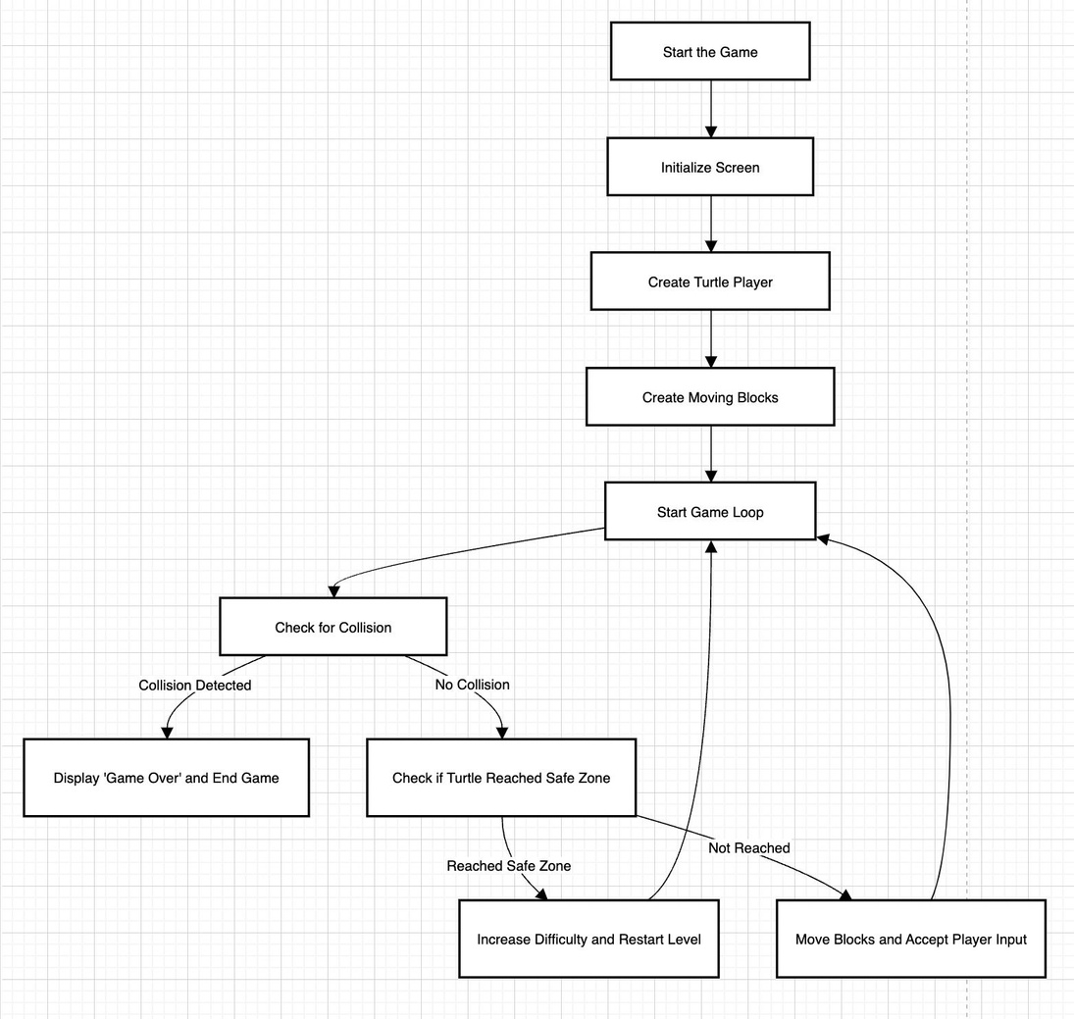
FlowChart

Slide 9
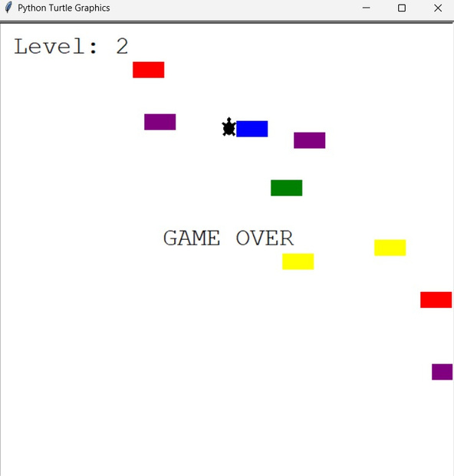
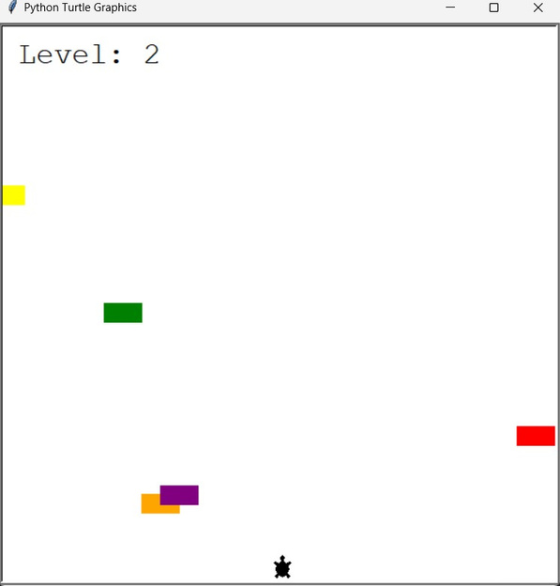
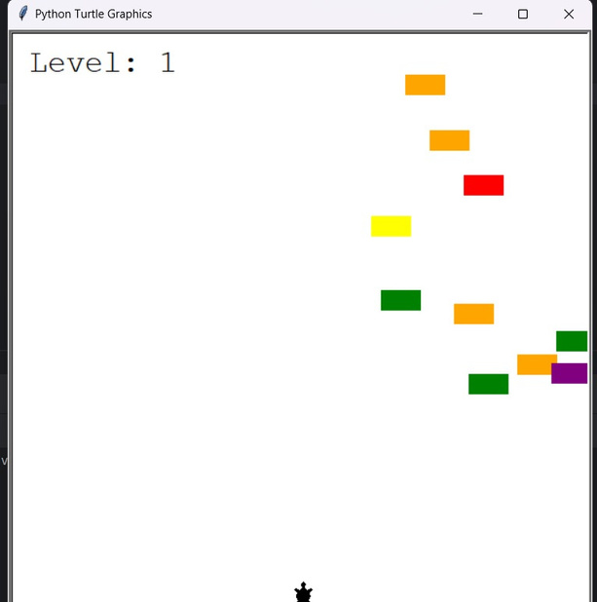
Snapshots

Slide 10
Testing and validation
Unit Testing: Verifies the functionality of individual components or methods.
Key Areas Tested: Player Movement, Collision Detection, Level Progression.
Integration Testing: Integration testing was conducted to validate the interaction between various components of the Turtle Crossing game.
Key Areas Tested: interaction between player and obstacles, level transition, resource management.
System Testing: System testing was performed to validate the entire workflow of the Turtle Crossing game.
Key Areas Tested: Smooth level loading, GUI update, obstacle behaviour

Slide 11
Conclusion
The Turtle Crossing game project successfully demonstrates the practical application of game development concepts using Python and the Turtle module. The game integrates dynamic mechanics, such as player movement and collision detection, with interactive elements like obstacle navigation and level progression to deliver an engaging and challenging experience. Key achievements of the project include the development of a fully functional game with responsive controls and a progressively challenging difficulty level. The modular code structure facilitates easy enhancements, while the visually appealing design and clear user interface contribute to player immersion.
Overall, the project serves as a valuable learning experience, showcasing the potential of Python for creating interactive games while providing a foundation for future enhancements and refinements.

Slide 12
Thank you!

